Slide 1
Level 6 Group 5
Jay Pointer, Dalton Kirk and Ashley Burton

Slide 2
Log Line- A social competitive snack game with tactical immersion.
Demographic - 18-24 Males, Mobile Users
Focus on skill and mastery
Males tend to enjoy competition
Goal- Compete against your friends, complete all zones and reach the highest rank.
Unlock cool loot as you go!

Slide 3
Player Experience and Fun
Player Experience
Curiosity – Future mechanics
Stress – Failing to complete levels
Fiero – Completion of levels
Hard fun

Slide 4
Mechanics – Boat Switching

Slide 5
Mechanics - Sails

Slide 6
Mechanics – Birds

Slide 7
Mechanics – Fire

Slide 8
Mechanics – Kraken!

Slide 9
Progression System
Players progress through the game by exploring zones
Zones will get tougher and require higher ranks
Completing an exploration rewards the player with experience
This experience will increase their Rank

Slide 10
Social Competition
Facebook integration
See your friends rank and compete
Post what you have unlocked (zones, cosmetics)

Slide 11
Rewards
Rewards will encourage players to keep playing our game
Rewards will make players feel better about playing our game
Getting rewards creates investment

Slide 12
How We Will Reward – New Sails
Fixed time reward – new random sail every 7th day you play the game
Cosmetic item that allows customisation
Creates daily habit of launching game (Hook model, Nir Eyal)
Peacock effect – Look at me now

Slide 13
How We Will Reward - Chests
A chest will be awarded to a player for completing an exploration.
Chests contain variable rewards specific to that zone.
Possible rewards from chests include: Unique sails, experience or unique pets

Slide 14
How We Will Reward - Skill
Skill reward - Bonus experience for playing well
Why? - Increase feeling of mastery, makes player feel good
Combos – E.g. tapping on birds in a row without missing one
Perfects – not making a single mistake. E.g. Not breaking the sails once on an exploration

Slide 15
Immersion
Tactical Immersion
In game where the skill required to complete a level brings a player into the game
Could be phrased as “In the Zone”

Slide 16
Tension and Release
Tension through each level
Increase overtime.
Keeping the player engaged.
Release once level is completed.
Release and Reward throughout the game
Rewards come with release.
Reward player with help on mechanics and score.
Repeating difficulty curve to keep the game interesting but accessible to players of all skill levels.
Learn, practice, master loop.
New mechanic
Hard
Tension
Time
Easy
Levels

Slide 17
Mobile Accessibility
UI
Size of everything on the screen
Art Style
Input
Short Levels

Slide 18


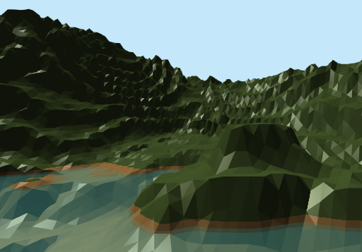
Art Style
Low poly 3d Art Style
Pastel Colours

Slide 19
Questions?

